Slide 1
CS 110 Principles of Web Development

Slide 2
Basics
Name: Mohammad Reza Zare Shahneh
Respond to: Mohammad Reza, Mohammad, Reza, Mo, Ray, Excuse me, …
Email: mzare008@ucr.edu
Subject: [CS110] – short description
Lab Session: M 5:00 PM - 06:50 PM | Skye Hall | Room 171
Office hours: Friday 9:00 AM – 11:00 AM
Zoom link: https://ucr.zoom.us/j/92271284007

Slide 3
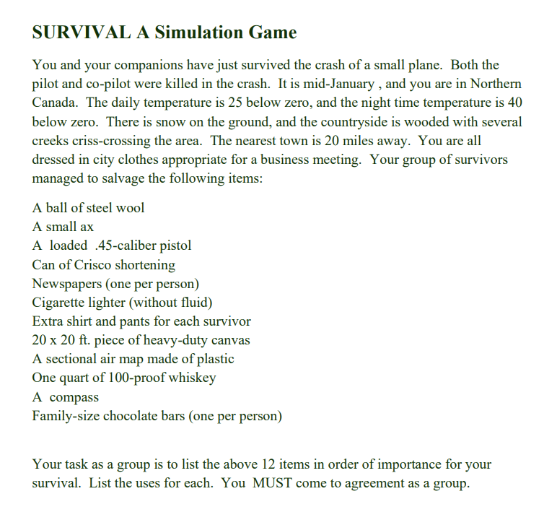
Bonding :D
Prisoners
100 prisoners in jail are standing in a queue facing in one direction. Each prisoner is wearing a hat of color either black or red. A prisoner can see hats of all prisoners in front of him in the queue but cannot see his hat and hats of prisoners standing behind him.
The jailer is going to ask color of each prisoner’s hat starting from the last prisoner in queue. If a prisoner tells the correct color, then is saved, otherwise executed. How many prisoners can be saved at most if they are allowed to discuss a strategy before the jailer starts asking colors of their hats.

Slide 4
Tools and useful websites
Live Share: https://marketplace.visualstudio.com/items?itemName=MS-vsliveshare.vsliveshare-pack
Live preview: https://marketplace.visualstudio.com/items?itemName=ms-vscode.live-server
WAVE: https://chrome.google.com/webstore/detail/wave-evaluation-tool/jbbplnpkjmmeebjpijfedlgcdilocofh
Flex box: https://css-tricks.com/snippets/css/a-guide-to-flexbox/

Slide 5
Lab1 Check list
General looks
Usability Requirements
Alt: to understand images
Headings: to skim though and get an idea of the structure
ARIA landmarks (Roles): to skim though and get an idea of the structure
Skip link: To skip to useful information
Responsiveness
Twitter icon in the middle

